Slide 1
Unit 10 lesson 29
Warm up
Write on your Slate
Bathroom
- bedroom
- kitchen
- living room
- dining room
- garden

Slide 2
Listening
Listen the song

Slide 3
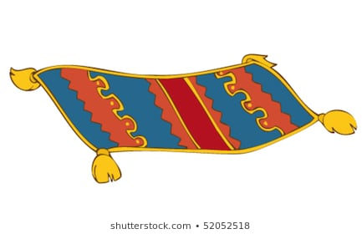
Look at the board now and listen
A Carpet
A Sofa

Slide 4
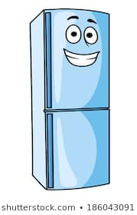
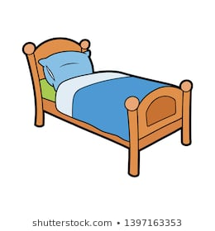
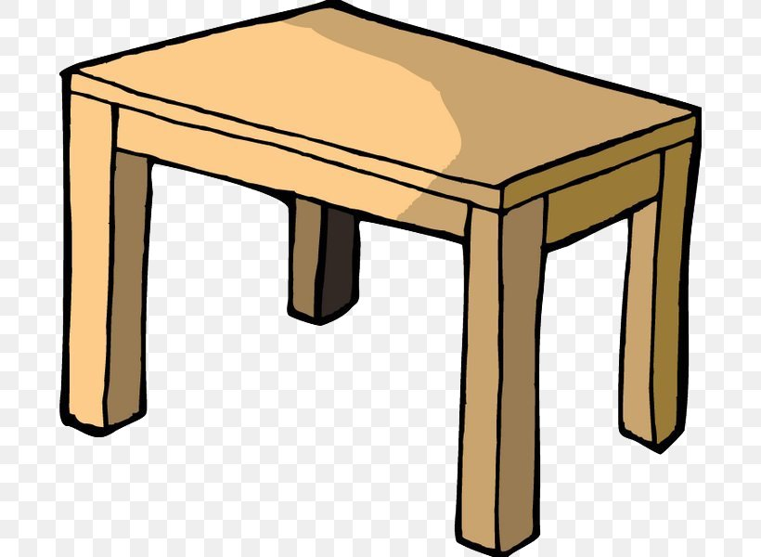
A Fridge
a Bed
A TV set
A Tabel

Slide 5
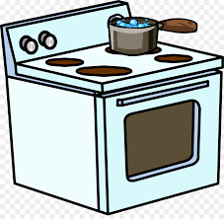
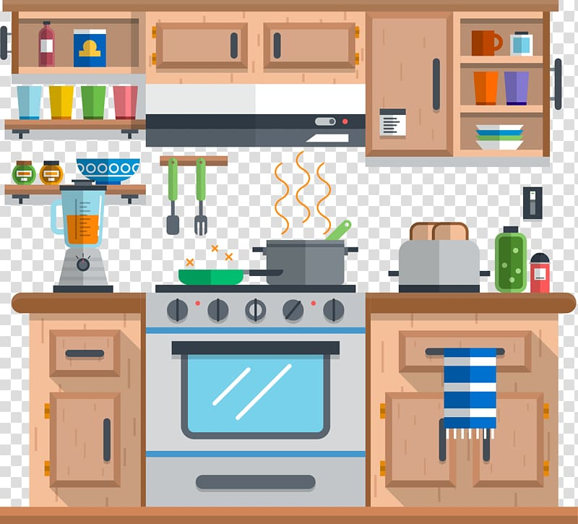
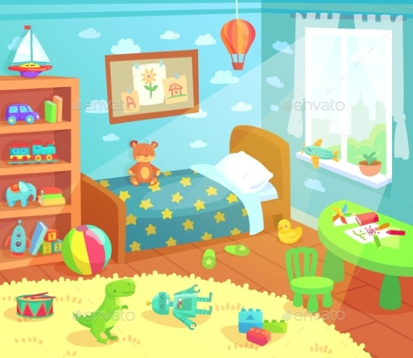
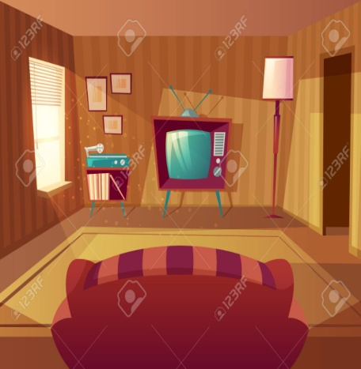
A Cooker
Match
Fridge
Cooker
Table
Sofa
Bed
TV
Carpet

Slide 6
I show, you say
A Sofa
A Fridge
A Cooker

Slide 7
Pupils sing
Reorder
o c k e r o
…………………………..
t a r e p c
…………………………………
fridge
cooker
g e d f r i
…………………………………….
Carpet

Slide 8
I ask, we answer
1 /What’s there in the kitchen?
There is a cooker / a fridge in the kitchen.
2/ what’s there in the bedroom?
There is a bed in the bedroom
3/what’s there in the living room?
There are a carpet and a sofa in the living room.

Slide 9
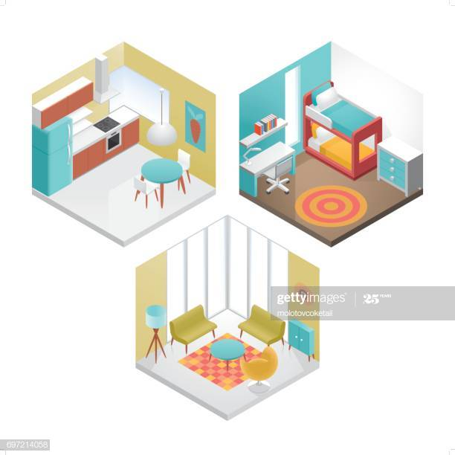
Where’s it?
Carpet
Fridge
Cooker
Sofa
Bed
Table
T.V

Slide 10
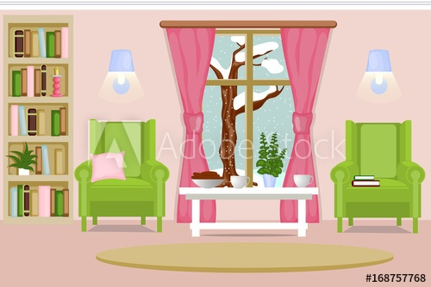
Writing
Look at the picture and describe it ( colors ,subjects…)
and use there is /there are
………………………………………………………………………………………………………………………………………………………………………………………………………………………………………………………………………………………………………………………………………………………………………………………

Slide 11
Il my livining room is big and very beautiful . There is a big window , a white table and a yellow carpet . There are two green chairs . Where I can read my favourite book every night befor going to bed .

